Slide 1
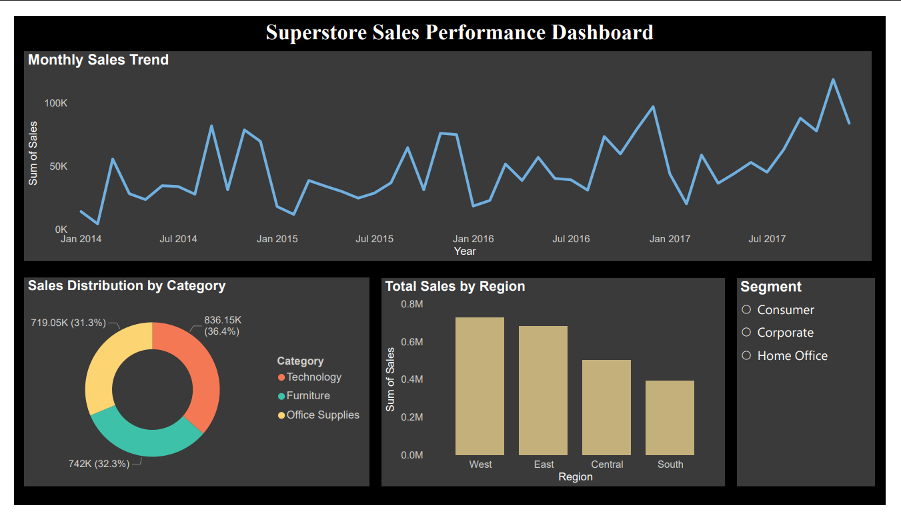
Superstore Sales Performance Dashboard

Slide 2
Key Insights
1. Regional Performance:
The West region generated the highest overall sales, indicating strong market demand and customer base in that area.
2. Sales Trend
Sales show consistent growth over time, with noticeable spikes during year-end months, suggesting seasonal demand patterns.
3. Category Contribution
The Technology category contributes the largest share of total revenue compared to Furniture and Office Supplies.
4. Customer Segment Impact
The Consumer segment accounts for a major portion of sales, making it the most significant revenue-driving segment.

